Slide 1





React Components
How to Compose in React
React Components
JSX
SoftUni Team
Technical Trainers
component
Software University
http://softuni.bg

Slide 2

Table of Contents
Components
Props
State
Component Lifecycle
Fetching Data

Slide 3
Have a Question?
sli.do #js-web

Slide 4

Components Overview
What are Components, Advantages, Syntax

Slide 5

Components Overview
Components are like JavaScript functions
They are reusable pieces that can be composed
You can customize them with props and state
class Welcome extends React.Component {
render() {
return <h1>Hello, {this.props.name}</h1>;
}
}

Slide 6
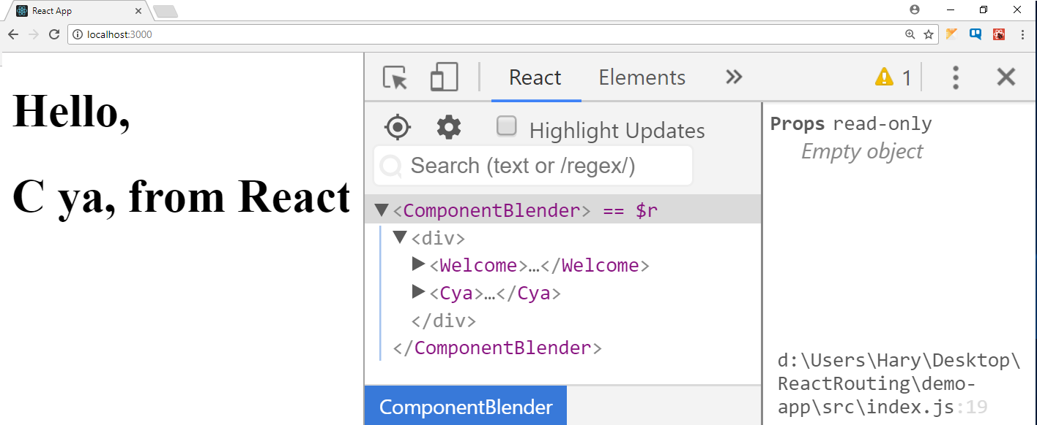

Composition
React components can be nested, like DOM elements
function Welcome() {
return <h1>Hello, from React</h1>;
}
function Cya() {
return <h1>C ya, from React</h1>;
}
function ComponentBlender() {
return (<div>
<Welcome />
<Cya />
</div>);
}
ReactDOM.render(<ComponentBlender />,
document.getElementById('container'));

Slide 7



Advantages
Encapsulate logic
Separate your code
Easier to maintain and debug
Allows reusability
Declarative syntax is easier to reason about
Components are neat

Slide 8

Component Syntax
Names always start with uppercase
Tags must be closed
If there are no children – use self-closing tags
Information is passed via props
<Dropdown> A dropdown list
<UserHead name='homeHeader' />
<Menu>
<MenuItem>Do Something</MenuItem>
<MenuItem>Do Something Fun!</MenuItem>
<MenuItem>Do Something Else</MenuItem>
</Menu>
</Dropdown>;

Slide 9

Component Props
Passing Data, Access and Usage

Slide 10
Component Props
Props is short for properties
Similar to HTML props – used to pass data to components
They should be considered immutable
A component should never modify it's own props!
function Welcome (props) {
return <h1>Hello, {props.name} </h1>;
}
Welcome.defaultProps = { name: "Pesho" };
You may set default properties

Slide 11
Component State
ON
OFF
Storing and Modifying Data

Slide 12
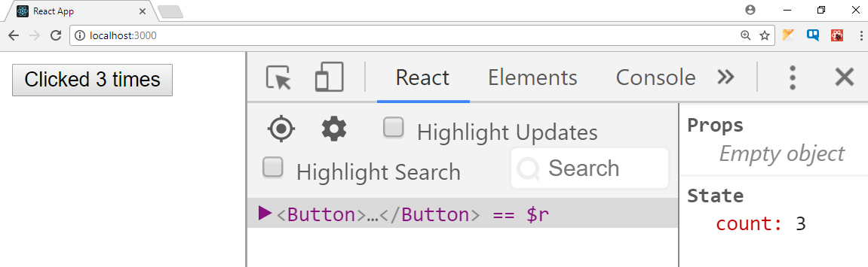
Component State and Initialization
State holds information that can change over time
Usually as a result of user input or system events
class Button extends React.Component {
constructor(props) {
super(props);
this.state = {count: 0};
}
updateCount() {
this.setState((prevState) => { count: prevState.count + 1 });
}
render() {
return (<button onClick={this.updateCount.bind(this)}>
Clicked {this.state.count} times</button>);
}
}

Slide 13
Working With States Overview
State is used with class-based components
Default state can be set in the constructor
To access state
State must never be directly modified
Use this.setState instead
New state will be merged
console.log(this.state[key]);

Slide 14

Component Lifecycle
Concepts, Usage and Event Hooks

Slide 15
Component Lifecycle
Components emit lifecycle events during operation
Those events can be used to perform initialization, fetch remote data, cleanup, etc.
Detailed information: https://reactjs.org/docs/state-and-lifecycle.html
Mount
Update
Dismount

Slide 16
componentDidMount() Hook
The hook is triggered after your component has been rendered
This is the point when you should initiate AJAX requests
Its good practice to add all your event listeners
Calling setState from this point on will cause a re-render
componetDidMount() {
fetch('https://gitconnected.com')
.then((res) => {
this.setState({
user: res.user
});
});
}

Slide 17
componentWillReciveProps () Hook
React triggers this method when new props will be received
You can check if there are changes in the incoming props
A common use-case for this is resetting state based on a change
componentWillReceiveProps(nextProps) {
if (this.props.id !== nextProps.id) {
this.setState({
feedContent: []
});
}
}

Slide 18
componentWillUnmount () Hook
This method is triggered right before the component dismounts
Here you can clean up everything that was associated with the UI
componentWillUnmount() {
window.removeEventListener('resize',
this.resizeEventHandler);
}

Slide 19
Other Lifecycle Hooks
shouldComponentUpdate – can be used to cancel an update
componentWillUpdate – triggered before an update occurs
componentDidUpdate – triggered after an update and may be used to resend AJAX requests
componentDidCatch – triggered when an exception is thrown

Slide 20

Fetching Remote Data
Using Fetch API

Slide 21


Fetch API
The Fetch API provides an interface for fetching resources
This method takes one mandatory argument, the path
It returns a promise that resolves to the Response to that request
You can also pass in an init options object as the second argument
fetch('https://api.github.com/users/xapuu')
.then((data)=>data.json())
.then((d)=>{console.log(d)})
.catch((err)=>{console.log(err)})
(async ()=> {
try{
let d = await fetch('https://api.github.com/users/xapuu')
let forDisplay = await d.json()
console.log(forDisplay)
}catch(e){
console.log('bam')}})()

Slide 22
Summary
Components are self-contained reusable elements
State and props can be used to pass information
Lifecycle events are fired during component operation
JSX supports the Fetch API
class Welcome extends React.Component {
render() {
return <h1>Hello, {this.props.name}</h1>;
}
}

Slide 23












React Components
https://softuni.bg/courses/

Slide 24

License
This course (slides, examples, demos, videos, homework, etc.) is licensed under the "Creative Commons Attribution-NonCommercial-ShareAlike 4.0 International" license

Slide 25





Trainings @ Software University (SoftUni)
Software University – High-Quality Education, Profession and Job for Software Developers
softuni.bg
Software University Foundation
http://softuni.foundation/
Software University @ Facebook
facebook.com/SoftwareUniversity
Software University Forums
forum.softuni.bg

